Slide 1
Mininet Code Walkthrough
Dr. Subhasri Duttagupta

Slide 2
What is Mininet?
Mininet is a form of emulator as opposed to a simulator
Mininet is a system that supports the creation of lightweight logical nodes that can be connected into networks.
Logical nodes are sometimes called containers, or, more accurately, network namespaces.
containers use very less resources and it’s possible to create a large number of nodes
Virtual-machine technology is NOT used in mininet.

Slide 3
Facts about Mininet
Mininet container is a process (or group of processes) that no longer has access to all the host system’s “native” network interfaces, much as a process that has executed the chroot() system call no longer has access to the full filesystem.
Mininet containers then are assigned virtual Ethernet interfaces (see the ip-link man page entries for veth), which are connected
to other containers through virtual Ethernet links. T
he use of veth links ensures that the virtual links behave like Ethernet,
though it may be necessary to disable TSO (12.5 TCP Offloading) to view Ethernet packets in WireShark as they would appear
on the (virtual) wire.
Any process started within a Mininet container inherits the container’s view of network interfaces.

Slide 4
Getting Started with Mininet
$sudo mn -h
Get mininet startup options
$sudo wireshark &
Wireshark is installed by default, else install it

Slide 5
Mininet CLI commands
Mininet>help
help display Mininet CLI commands
nodes - display nodes
net - display links
Dump information about all nodes (hosts) and switches
The command ifconfig runs on host h1
Mininet>nodes
Mininet>net
Mininet>dump
mininet>h1 ifconfig -a

Slide 6
Same Network Namespace
All hosts and switches see the same namespace
Shows the set of processes running on h1
Shows the set of processes running on s1
h2 is replaced by its IP address, host h1 pings h2
Dump information about all nodes (hosts) and switches
The command ifconfig runs on host h1
Does all pair ping
mininet> h1 ps -a
mininep> s1 ps -a
mininet> h1 ping –c 1 h2
mininet>dump
mininet>h1 ifconfig -a
mininet>ping all

Slide 7
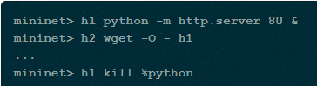

Run a web server and create a topology
Python3 it is called http.server and Python2 it is called SimpleHttpServer, specify either python2 or python3
mininet> py sys.version
Display python version used
mininet> py sys.version
To start mininet clean, if there’s any problem
$sudo mn -c
$sudo mn -c
$sudo mn –test iperf
runs iperf server on one host and iperf client on another
Creates a topology with single switch and 3 hosts and runs a regression test
$sudo mn –test pingall --topo single,3
Creates a topology with each host having a switch and all switches connect in a line
$sudo mn –test pingall --topo linear,3

Slide 8
Link variations
We can set the link parameters automatically from the command line
if we set delay 10ms the round trip time would be 40ms as it traverses two links, one to switch and one to the destination host
$sudo mn –link tc, bw=10, delay=10ms
mininet>iperf
mininet>h1 ping –c10 h2

Slide 9
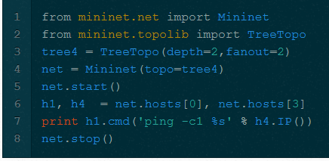
Customizing a Network
Mininet API allows to create custom topology

Slide 10
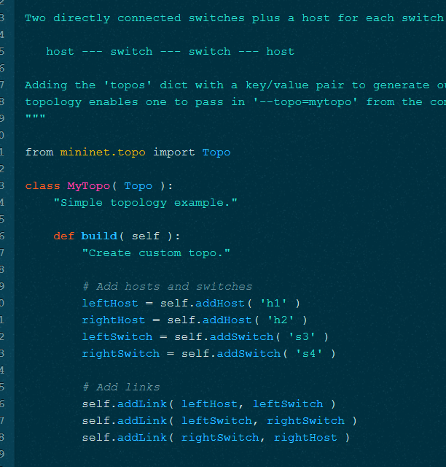
Custom Topology
addLink – adds a link
addHost – to add hosts and switches
Command to use
mn --custom ~/custom/2sw-2host.py --topo mytopo --test pingall
addlink

Slide 11
More Options for starting mininet
--mac option - sets the host MAC and IP address to small, unique, easy-to-read IDs.
By default, hosts start with randomly assigned MAC addresses.
with default MAC address, correlating control traffic to specific hosts is tough.
-x option can start an xterm for every host and switch.
Xterms are useful for running interactive commands

Slide 12
Using custom switch and controller
using –switch option to obtain custom switch and controller
sudo mn --switch ovsk --test iperf - to run open vSwitch
sudo mn --switch user --test iperf - to run user space switch

Slide 13
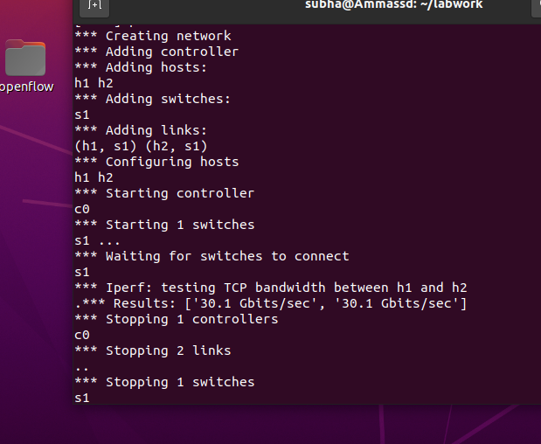
Openflow switch shows higher bandwidth
vSwitch shows 30Gb/s bandwidth
user space switch shows 479 Mb/s

Slide 14
Mininet CLI
To see command line interface, run a topology and keep it running
command gets executed by
Python if it starts with py
See the methods and properties available for a node run dir command
mininet>py ‘hello’ + ‘world’
mininet>py dir(s1)

Slide 15
Mininet Python API
The Mininet Python API consists of a number of Python classes, such as Topo, Mininet, Host, Switch,
Link and their subclasses. The API is built at three primary levels which provide different level of abstractions for customizing the network topologies. Here is a brief description of the levels:
Low-level API: This API includes the base node and link classes such as Host, Switch and Link.
You can directly instantiate some objects from these classes to create a network.
Mid-level API: This API consists of the Mininet class which provides a number of methods,
such as addHost(), addSwitch(), and addLink(), for creating a network.
High-level API: This API consists of the Topo class, which provides the ability to create reusable, parameterized topology templates. These templates can be passed to the mn command (via the --custom option as in Part 2 above) and used from the command line.

